Slide 1

Project Name: Study Organizer
Class: Advanced Programming with Python Date: November 4, 2025
Section: Section 2
Team: Group 13
Presented by: Kadir Güven

Slide 2

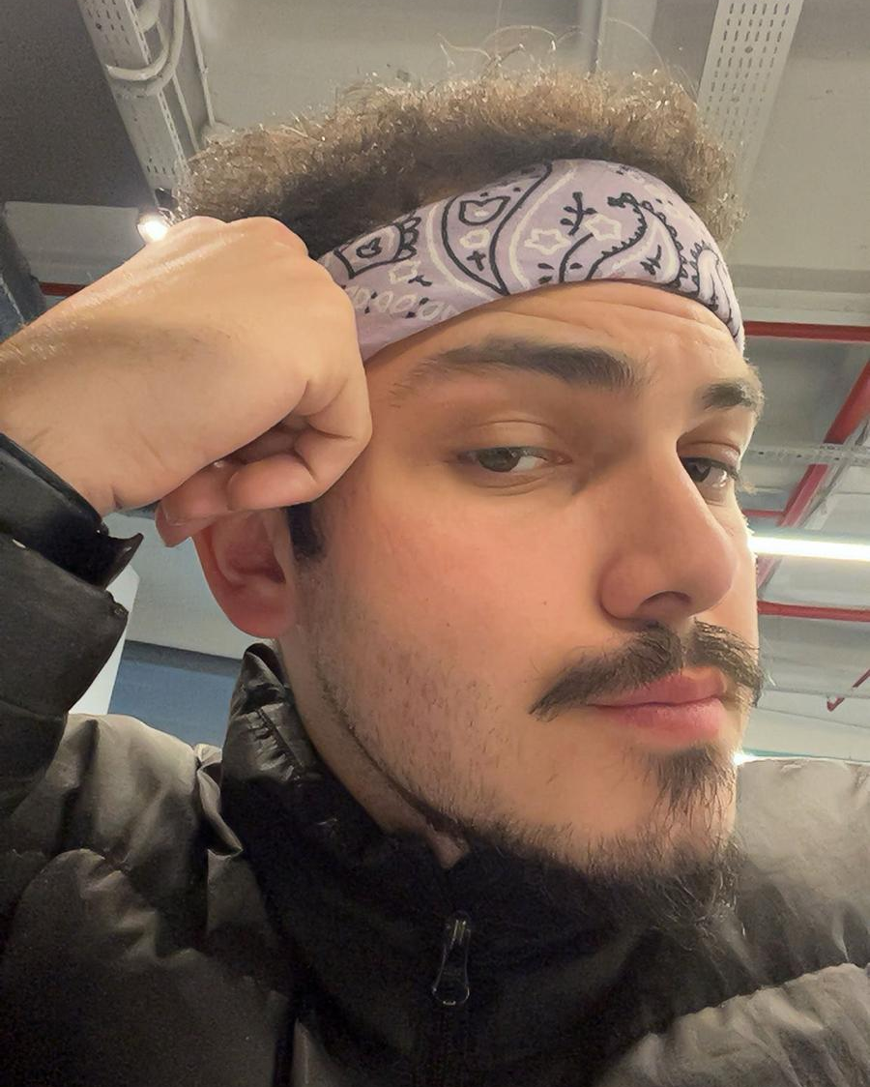


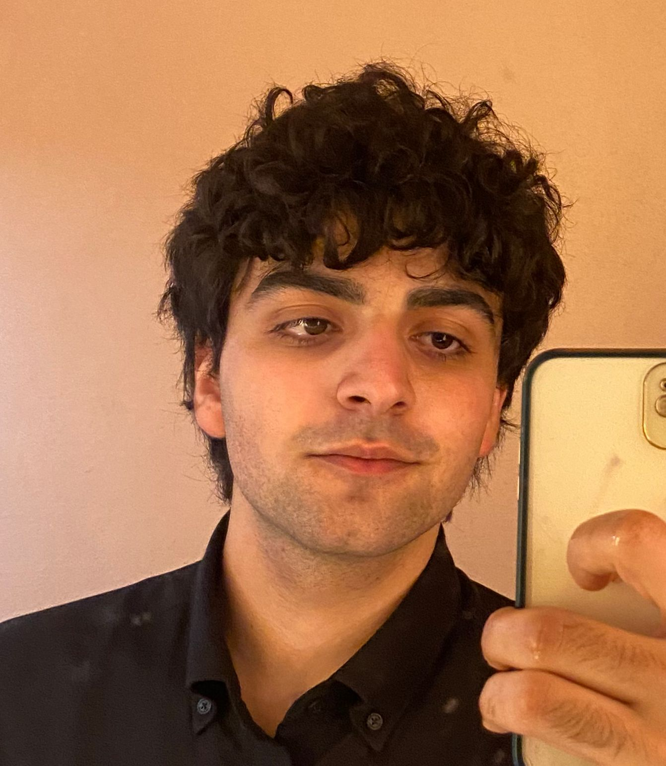
Our Team - Group 13
Ertuğrul Doğan
İlyas Güney
Görkem Veysel Göksu
Kadir Güven
Cemal Batuhan Baş

Slide 3
What Did We Build?
User-typed tasks and optional due dates selected from the calendar.
1-INPUT
The application formats the task, adds it to the list, and manages the data.
2-PROCESS
A persistent task list, displayed in the app and saved instantly to tasks.txt.
3-OUTPUT
We built a 'Study Organizer‘ program. The input is a task, with an optional due date from a calendar, and the output is a persistent task list, saved instantly to a local file.

Slide 4
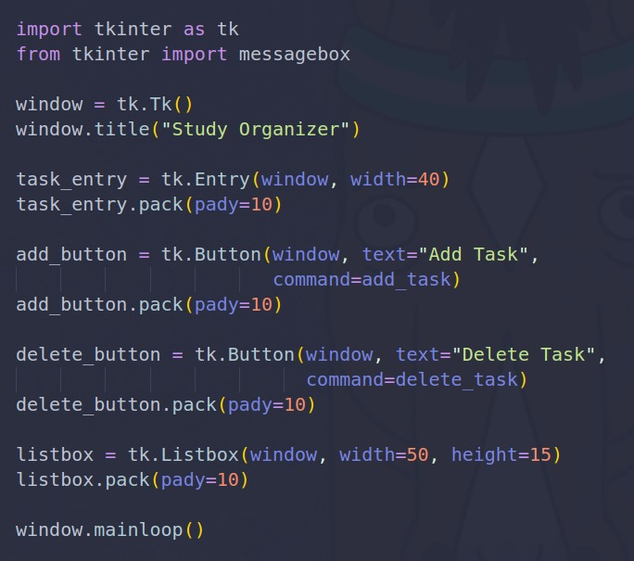
How Slide 1: The GUI
GUI Development:
Used the ‘tkinter’ library to create the main application window.
Widget Implementation:
‘tk.Entry’ to get text input from the user.
‘tk.Listbox’ to display the saved tasks.
Event Handling:
Used ‘tk.Button’ to trigger functions when clicked.
The ‘command=add_task’ parameter links the button to its Python function.
User Feedback:
Imported the messagebox module to show warnings to the user.
Application Lifecycle:
The application was started with the ‘window.mainloop()’ command.

Slide 5
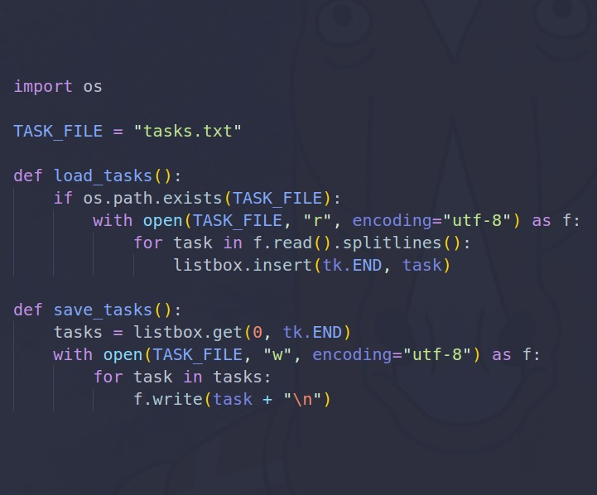
How Slide 2: Data Persistence & File I/O
File I/O:
Used ‘with open()’ for safe file handling, which automatically closes the file even if errors occur.
Data Persistence:
Tasks are loaded from the file in 'read' mode (r).
Tasks are saved to the file in 'write' mode (w) to overwrite the data.
Standard Library (os):
Used the os module to check if the file exists.
Error Prevention:
The ‘os.path.exists()’ check prevents the app from crashing with a FileNotFoundError on its first launch.

Slide 6
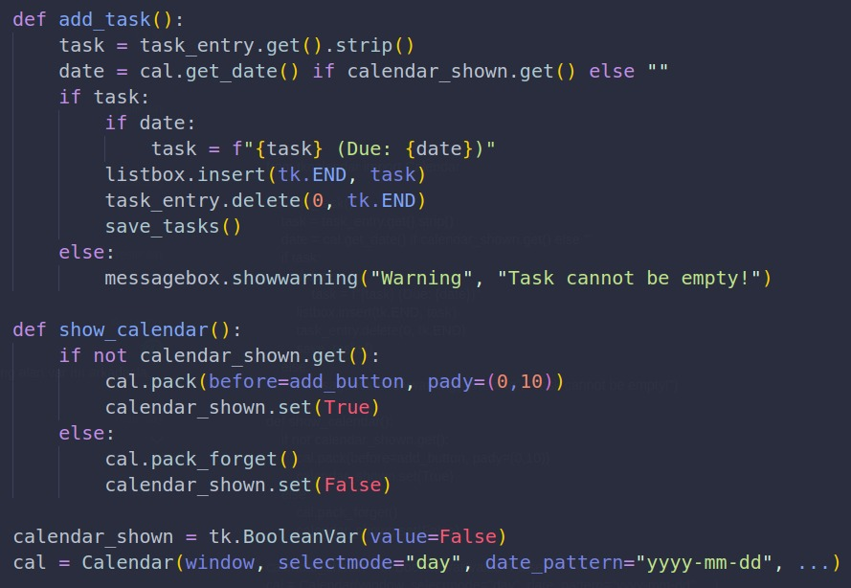
How Slide 3: Novelty (External Library)
External Library:
Integrated the external 'tkcalendar’ library to add extra functionality (date selection).
Widget Integration:
The Calendar widget was created and integrated with the add_task function.
Dynamic GUI:
The calendar is dynamically shown and hidden by pressing a button.
Data Formatting:
The date from ‘cal.get_date()’ is formatted and added to the task string.

Slide 7
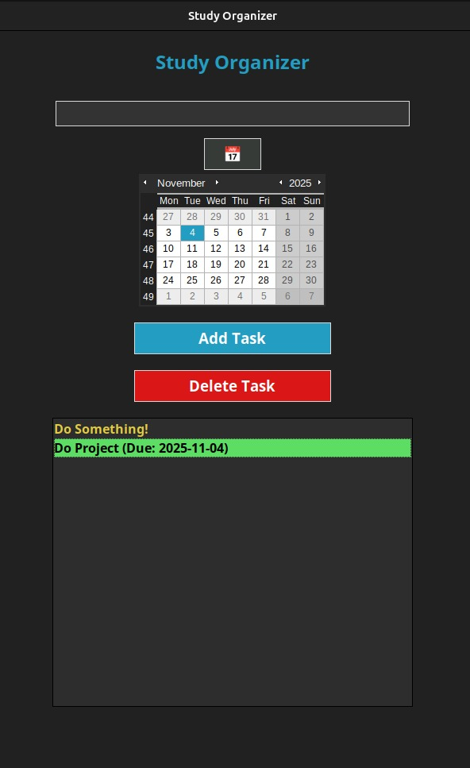
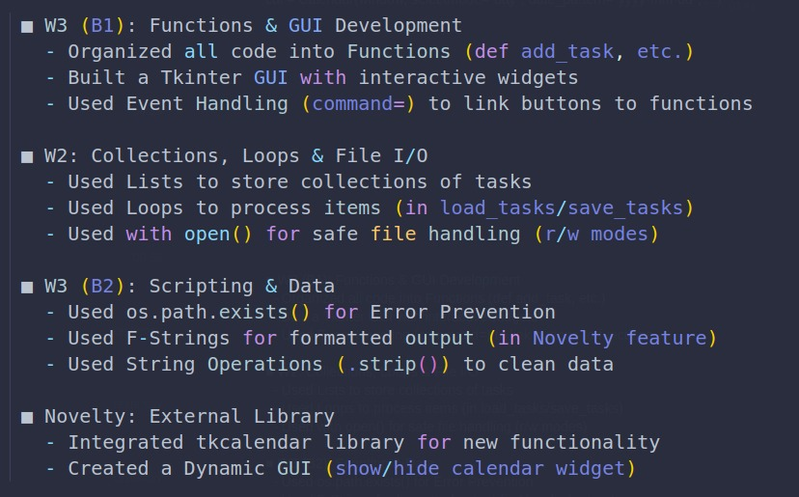
Summary of Topics Covered & Interface

Slide 8

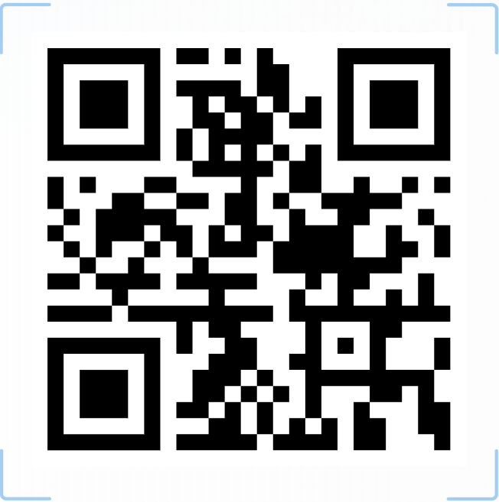
Ertuğrul Doğan: Presentation Designer
İlyas Güney: Code Developer
Kadir Güven: The Presenter
Görkem Veysel Göksü: Concept Finder
Cemal Batuhan Baş: Concept Finder

